Slide 1
Internship at SAP Concur
Chyanne Haugen

Slide 2
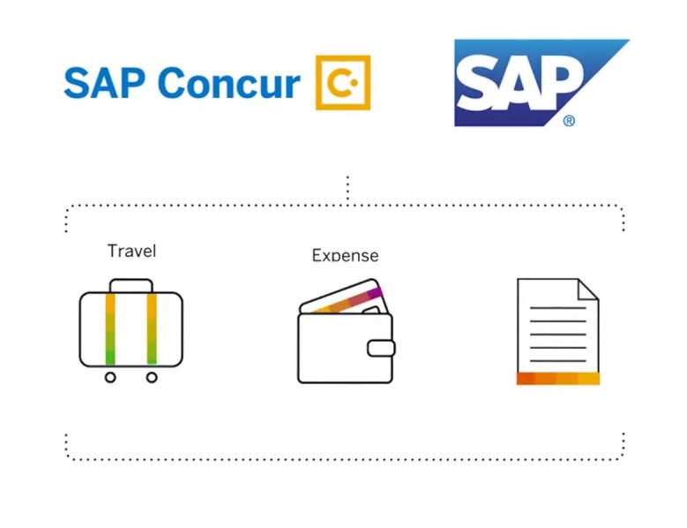
SAP Concur is a software as a service company
Produces and maintains
travel, expense, and invoice management services for businesses

Slide 3
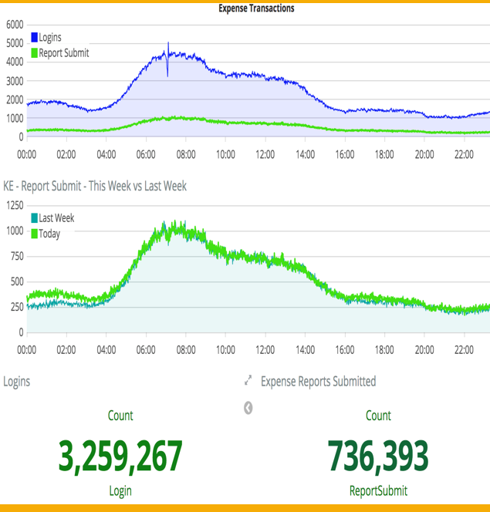
Worked on team moving current service into Amazon web services (AWS)
Team owned the profile service, which contains all user data.

Slide 4
Tasks completed during Internship
Developed monitor using an AWS lambda function to continuously test if service is running
Updated fields stored in an SQL database
Implemented a new feature using Clojure to properly sync data fields in DynamoDB coming from an SQL database.

Slide 5
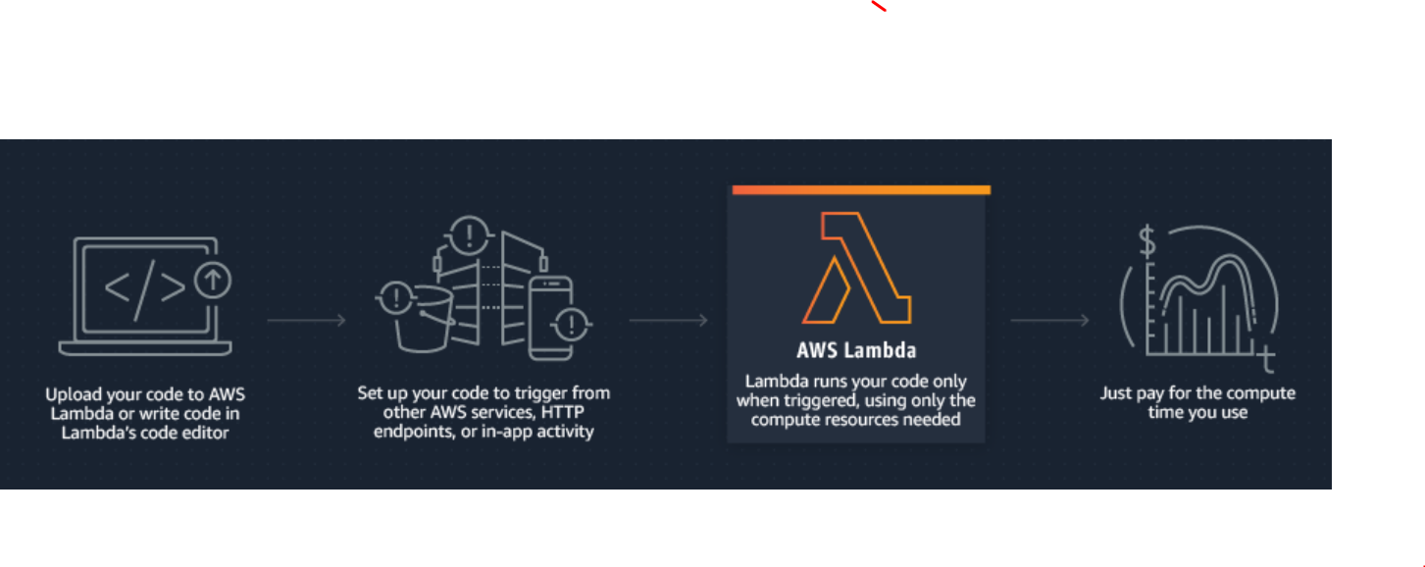
AWS Lambda
Used an AWS Lambda function to develop the testing monitor
AWS Lambda is a serverless compute service

Slide 6
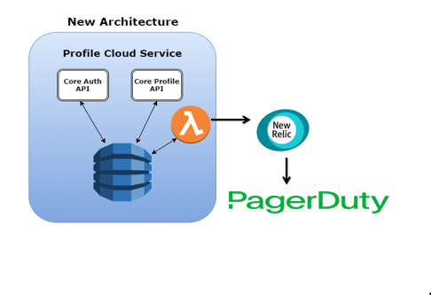
Main project
Used an AWS lambda function and Ruby to continuously test if service is running
Designed to work with New Relic to immediately notify Slack and PagerDuty if service goes down.

Slide 7

Technologies used during Internship:

Slide 8
